Slide 1
Introduction to XML Lecture 1: Part 2 XML Parser
Eng. Marwa Abdel Hamid

Slide 2
XML Parser
XML Parser is a software that reads XML document so that you can read and update – create and manipulate – an XML document.
XML Parser reports any error to the application and the application responsible to handle this error.
The parser is not allowed to fix the documents’ errors; it is only responsible for error reporting.

Slide 3
XML Parser in browsers
All modern browsers have a built-in XML parser that can be used to read and manipulate XML.
The parser reads XML into memory and converts it into an XML DOM object that can be accessed with JavaScript.

Slide 4
MSXML Parser
Different versions of MSXML are included with various Microsoft products, such as Microsoft Windows, Microsoft Internet Explorer, Microsoft Office, and Microsoft SQL Server.
https://support.microsoft.com/en-us/help/269238/list-of-microsoft-xml-parser-msxml-versions
MSXML is also updated when you install software updates for various Microsoft products.

Slide 5
XML Parse (Cont’d)
XML Parser
object-based interfaces
(DOM)
event-based interfaces
(SAX)
Document Object Model
Simple APIs for XML

Slide 6
Object Based Interfaces (DOM)
Using an object-based interface, the parser explicitly builds a tree of objects that contains all the elements in the XML document.

Slide 7
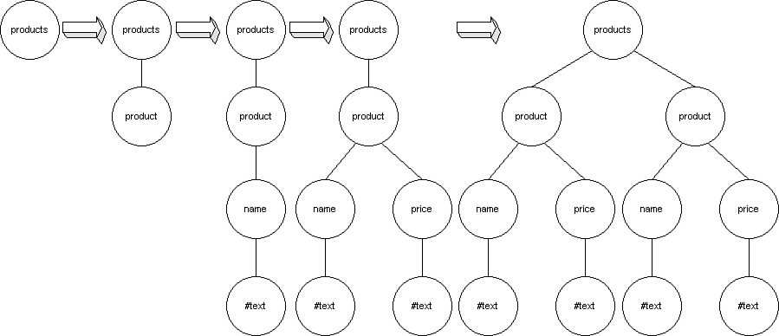
Object Based Interfaces(cont’d)
The parser reads XML document and gradually builds a tree of objects that matches the document.
<products><product><name>#text</name><price>#text</price></product>
<product><name>#text</name><price>#text</price></product></products>

Slide 8
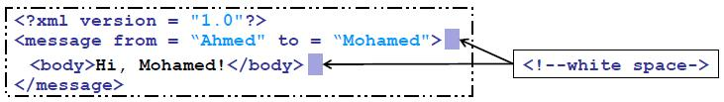
Object Based Interface (cont’d)
DOM tree:
– Is constructed from nodes.
– Each node represents an element, attribute, space -- etc.
Ex.:
– Node created for element message “Root Node”
• Element message has:
– 1 Child node “body element ”
– 2 spaces nodes.
– 2 Attributes nodes “from and to”
• Element body has child node for text "Hi, Mohamed!"

Slide 9
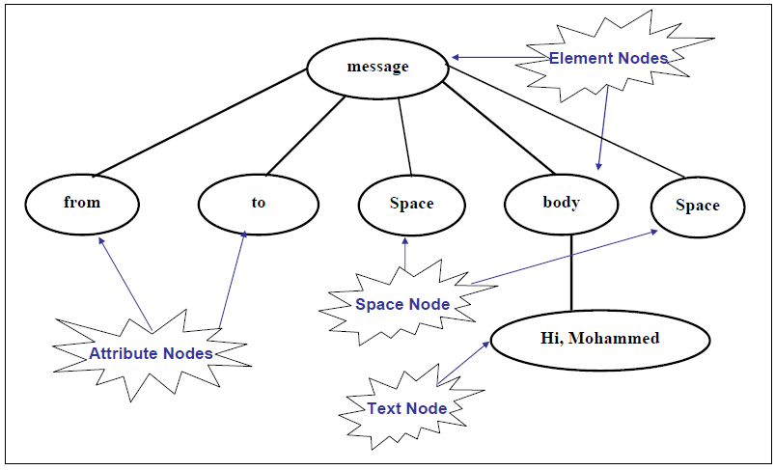
DOM Tree in Computer Memory

Slide 10
object-based interfaces (DOM)
DOM: Document Object Model
DOM was developed by W3C
DOM is a platform and language interface that allows programs to dynamically access and update the content and structure of a XML document.

Slide 11
object-based interfaces (DOM) cont’d
Most parsers support DOM
DOM has defined classes of objects to represent every element in an XML file. There are objects for elements, attributes, entities, text, and so on

Slide 12
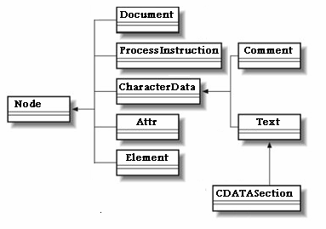
DOM hierarchy

Slide 13
Event-Based Interfaces (SAX)
The parser does not explicitly build a tree of objects, The xml document is read sequentially.
It reads the file and generates events as it finds elements, attributes, or text in the file.
Parsing events such as: document starts, document ends, element starts, element ends, attributes, text content, entities, and so on.
When a parsing event happens, the parser invokes the corresponding method of the corresponding handler. The handlers are programmer’s implementation of standard Java API (i. e. , interfaces and classes)

Slide 14
Event Based Interfaces (cont’d)
The application has to listen to events and determine which tree is being described.
With each parsing event, the parser sends sufficient information about the node being parsed.

Slide 15
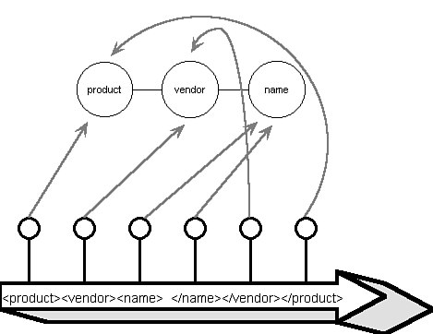
Event Based Interfaces (cont’d)

Slide 16
DOM vs. SAX
• DOM
– Tree-based model
– Stores document data in node hierarchy
– Provides facilities for adding and removing nodes
• SAX
– Invoke methods when markup (specific tag) is encountered
– Greater performance than DOM
– Less memory overhead than DOM
– Typically used for reading documents (not modifying them)

Slide 17
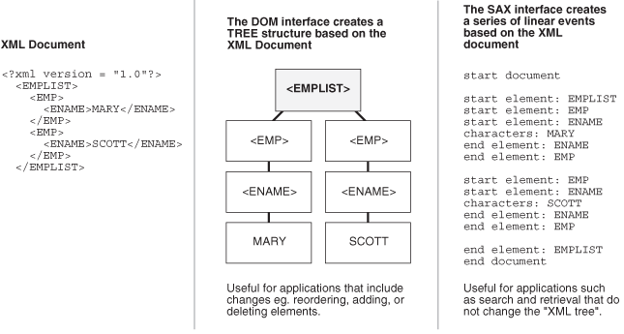
DOM vs. SAX (cont’d)
https://docs.oracle.com/cd/B28359_01/appdev.111/b28394/adx_j_parser.htm#ADXDK19097

Slide 18
Examples

Slide 19
Steps of using a DOM Parser
Creating an XML document object
Loading an XML file into the parser
Manipulating the data

Slide 20
Creating and loading an XML document from an external file
<data>
<name>Aly</name>
<address>smouha</address>
</data>
In javascript:
var xmlDoc=new ActiveXObject("Microsoft.XMLDOM");
xmlDoc.async="false";
xmlDoc.load(“emp.xml");
Document.write(xmlDoc.documentElement.childNodes[0].text);
xmlDoc.documentElement.childNodes[0].text=“Ahmed”;
xmlDoc.save(“emp.xml”);
data

Slide 21
Traversing data in an XML document
var doc=new ActiveXObject(“Microsoft.XMLDOM”);
doc.async=false;
doc.load(“emp.xml”);
var x=doc.documentElement;
for(i=0;i<x.childNodes.length;i++)
{
document.write(x.childNodes[i].nodeName);
document.write(“=“);
document.write(x.childNodes[i].nodeValue);
document.write(“<br/>”);
}

Slide 22
Accessing XML element by Name
var doc=new ActiveXObject(“Microsoft.XMLDOM”);
doc.async=false;
doc.load(“emp.xml”);
document.write(“The employee name is:”);
document.write(doc.getElementsByTagName(“name”).item(0).text)
<data>
<name>Aly</name>
<address>smouha</address>
</data>

Slide 23
LoadXml function in C#
//Create the XmlDocument. XmlDocument doc = new XmlDocument(); doc.LoadXml(("<Student type='regular' Section='B'><Name>Tommy </Name></Student>"));
Doc.getElementsByTagName(“Name”).value=“Ahmed”; //Save the document to a file. doc.Save("std.xml");

Slide 24
LoadXml function in C#
//Create the XmlDocument. XmlDocument doc = new XmlDocument(); doc.Load(“std.xml”);
Doc.getElementsByTagName(“Name”).value=“Ahmed”; //Save the document to a file. doc.Save("std.xml");

Slide 25
Creating and loading an XML document
XmlDocument xmlDoc= new XmlDocument(); //* create an xml document object. xmlDoc.Load("yourXMLFile.xml"); //* load the XML document from the specified file. //* Get elements. XmlNodeList St_Address = xmlDoc.GetElementsByTagName("Address"); XmlNodeList St_Age = xmlDoc.GetElementsByTagName("Age"); XmlNodeList CellPhoneNumber = xmlDoc.GetElementsByTagName("Phone"); //* Display the results. Console.WriteLine("Address: " + St_Address[0].InnerText); Console.WriteLine("Age: " + St_Age[0].InnerText); Console.WriteLine("Phone Number: " + CellPhoneNumber[0].InnerText);

Slide 26
Microsoft working with XML
System.Xml Namespace
https://docs.microsoft.com/en-us/dotnet/api/system.xml?view=netframework-4.7.2
XMLReader
https://docs.microsoft.com/en-us/dotnet/api/system.xml.xmlreader?view=netframework-4.7.2
LINQ to XML
https://docs.microsoft.com/en-us/previous-versions/bb387098(v=vs.140)

Slide 27
XML Project Using DOM
name
phone
address
email
prev
next
search
insert
update
delete
save

